Slide 1

DeQA: On-Device Question Answering
Qingqing Cao, Noah Weber, Niranjan Balasubramanian, and Aruna Balasubramanian
Notes:
Good morning everyone! I’m Qingqing Cao, from Stony Brook University. Today, I’m going to talk about DeQA: on-device question answering, this is a joint work with Noah, Niranjan and Aruna.

Slide 2




Device-wide Question Answering Example
Scenario: Mateo is looking for medication for his diabetic son
Friends’ suggestions
Vendor websites
Doctor prescriptions
When in the pharmacy, Mateo needs the answers to
What’s the price of the drug I found earlier on the web?
Did my friends give some alternatives?
Did the doctor say any restriction of the drug?
Notes:
Imagine a scenario like this: Mateo is looking for medication for his diabetic son.
He has gathered suggestions from his friends on social media. He also has browsed vendor sites, more importantly, he has discussed with his son’s physician over email.
Now when Mateo is in the pharmacy, he needs the answers to the following questions:
What’s the price of the product I found earlier on the vendor website?
Did my friends give some alternatives?
And did the doctor say any restriction of the drug?
To answer these questions, we need to search through all the data accessed from the device, across multiple apps. We call this device-wide QA
[pause 3s]

Slide 3



No Support for Device-wide QA
Alternatives his friends suggest?
Any restrictions given by the doctor?
The product price found earlier?
Burdensome!
Privacy!
entire device data
QA service providers
Notes:
Unfortunately, there is no support for device-wide QA today.
Either Mateo can open each app on his phone and then he can use a QA service if the app provides one.
This is too burdensome for him
Or Mateo has to send the entire device data, everything he has accessed across multiple apps to a cloud provider.
Then he can use a personal assistant like Siri or Google Assistant.
There is a huge privacy risk.

Slide 4
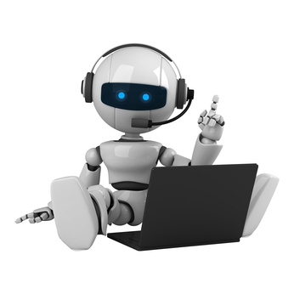
Our Solution: On-Device QA
Alternatives his friends suggest?
Any restrictions given by the doctor?
The product price found earlier?
Cross
App
Data
Store and index
Notes:
Our solution is to develop an on-device question answering system.
When the user interacts across multiple apps, the data is stored locally on the device.
We then build a QA system over this local data. Specifically, our on-device QA system will build an index and answer questions completely locally.
In fact, you don’t even require Internet access to answer these questions.
The problem is that building such an on-device QA system on a mobile device is challenging.

Slide 5
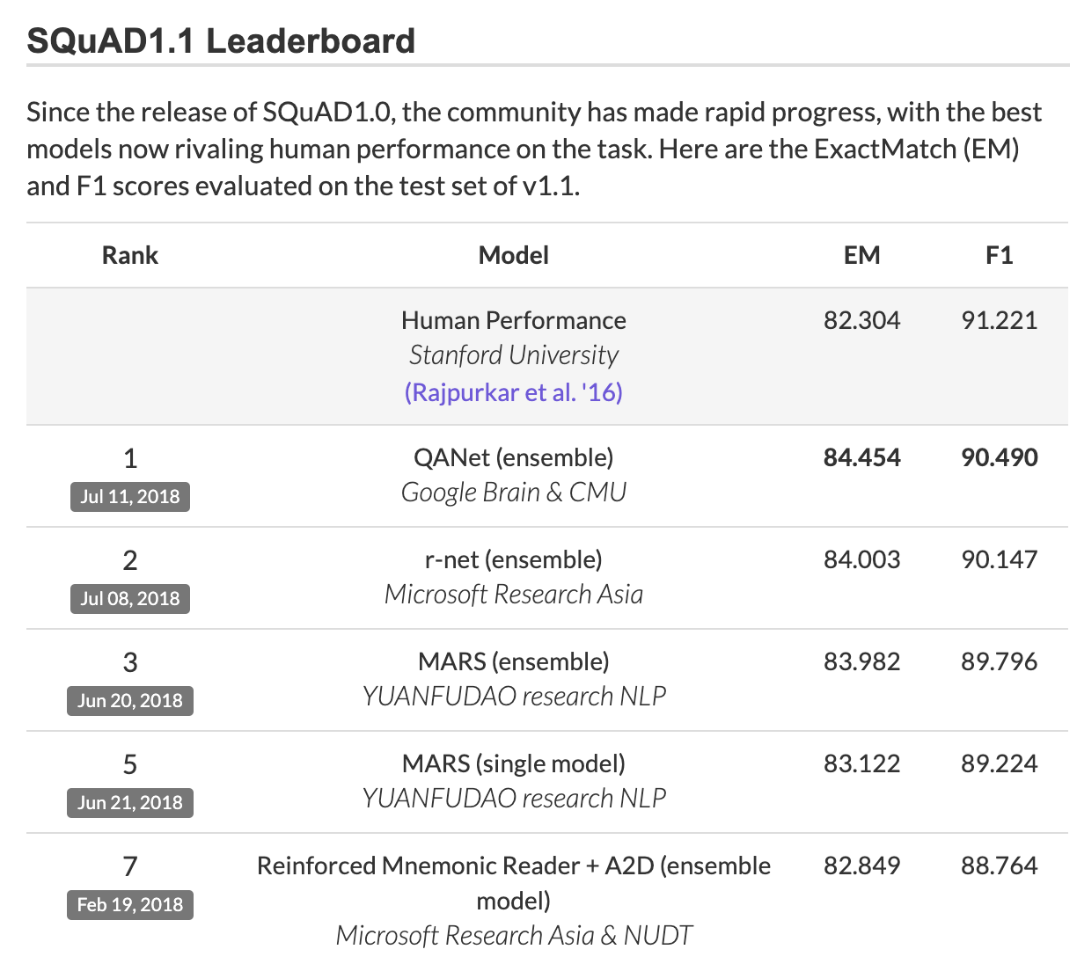
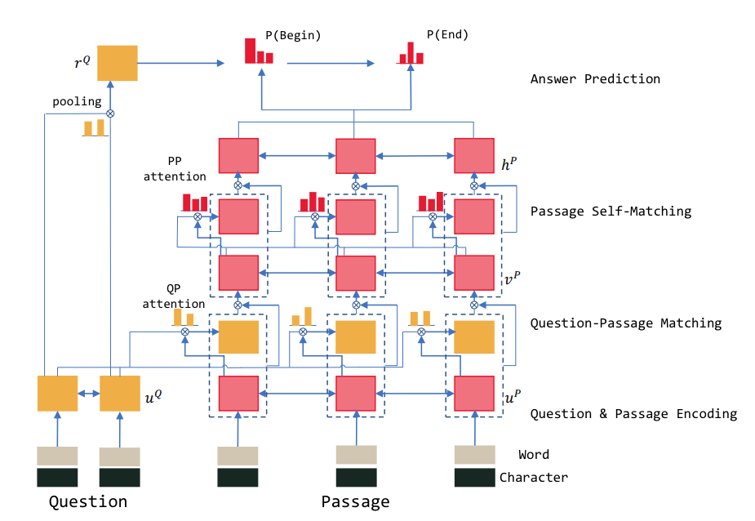
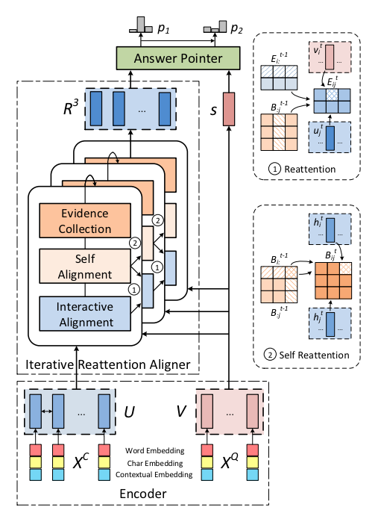
State-of-the-art QA systems Use Deep Learning
large and complex deep models
Notes:
The state-of-the-art QA systems all use deep learning techniques.
This figure shows the top models on the SQuAD Leaderboard. SQuAD is a question answering datasets that researchers can evaluate their QA models performance.
All the top models are using deep learning which is very good at modeling text and is widely adopted for QA.
Here are some example model architectures. And these models are often large and complex.

Slide 6
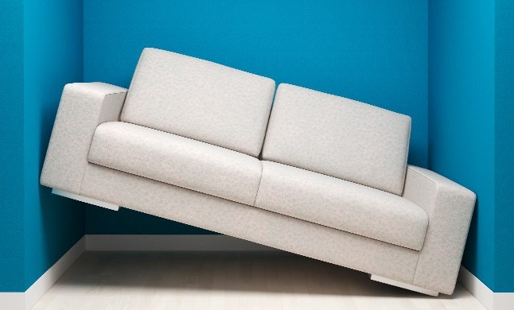
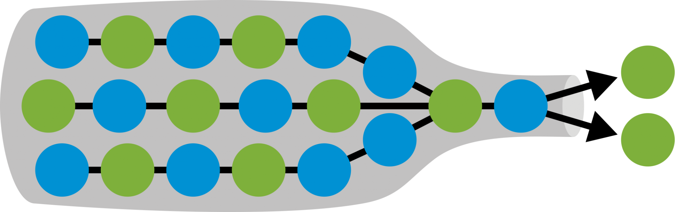
On-Device QA Challenges
computation needed
deep learning QA system
results
device “memory” available
Doesn’t fit into memory!
Extremely slow!
Notes:
These complex QA models are designed to run on the cloud.
The problem is we cannot even load any top QA system on mobile devices today as is because it doesn’t fit into memory.
And due to the large computation required, it runs extremely slow.

Slide 7

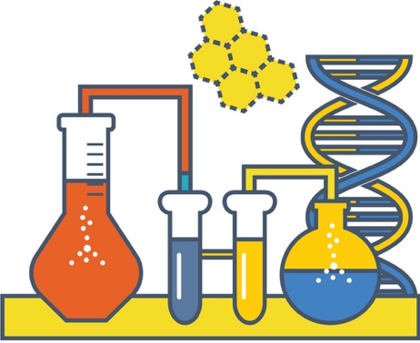
DeQA: On-device Question Answering
Measurement study
DeQA latency and memory optimizations
DeQA evaluation
Notes:
In this work, I will present DeQA, a system that stands for On-Device QA.
I will first describe the measurement study we conducted of the state-of-the-art QA models to learn the bottlenecks of existing QA.
I will then describe the DeQA latency and memory optimizations.
And finally the evaluation of DeQA.

Slide 8
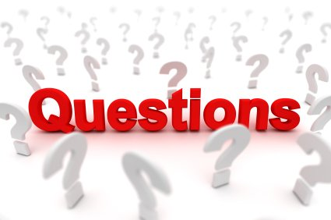

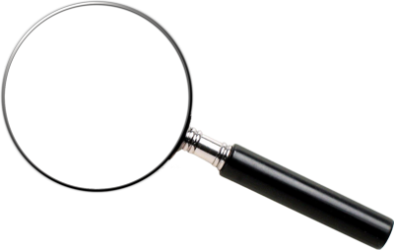
QA System: Background
Answers
QA System
QA Model
Data collection
Search Engine
Notes:
Before we discuss the measurement study, let me first explain the QA pipeline.
Usually question answering works as follows. There is a large collection of documents data—this can be Wikipedia which is the widely used in the QA community,
or it can be personal cross-application documents that we are envisioning for device-wide QA
The goal of a QA system is return an answer from the data collection in response to a question.
Generally, a QA system has two stages, the first stage is a search engine stage and the second one is a QA model.
[cross-app caption, fix arrow colors]

Slide 9
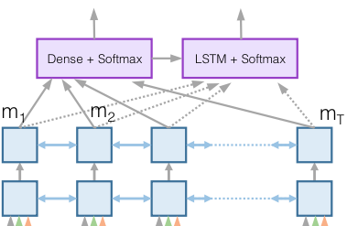


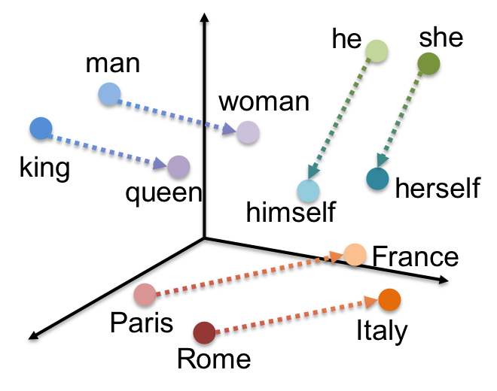
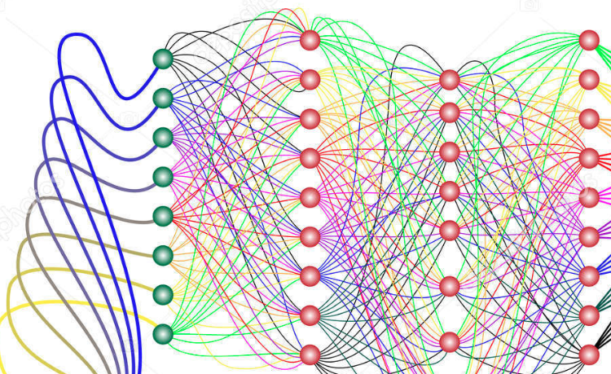
QA System: Background
When did the second world war end?
Answer: 1945
Scoring Answers
QA Model
second, world war, end
Embeddings
(Text Representations)
Neural Encoding of
Documents and Question
Top Relevant
Documents
Documents
Search Engine
Notes:
Let me give you an example, you have a question, say “When did the second world war end”,
the search engine will first transform the question into a set of keywords and then find the top relevant documents in the data collection.
In the second stage, the system runs complex QA models on the top relevant documents. As mentioned before the state-of-the-art QA models often use deep learning techniques.
The QA model needs to use the information of question and documents, the first step is to represent the words in them as embeddings. Embeddings are used to represent words where words with similar usages and meaning are in the same vector space.
Then these embeddings are used as input to neural encoding layers which further represent the question and documents. The QA model runs on this representation to find answer phrases, score them, and then return the answer.

Slide 10
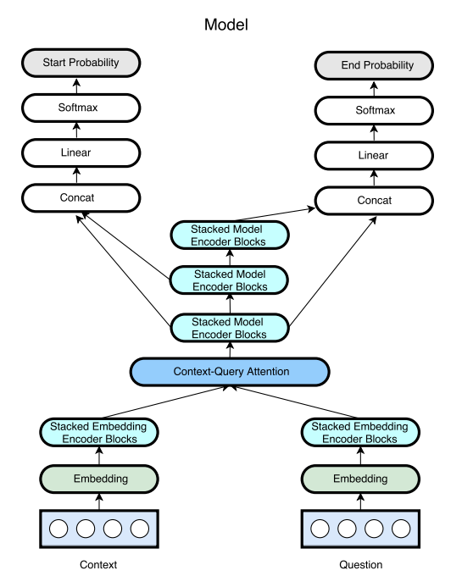
Study Methodology
Goal: understanding the bottlenecks in diverse QA models
RNet (Wang, et al)
MReader (Hu, et al)
QANet (Yu, et al)
Different model architectures
but share common pipeline!
Top3 models on the SQuAD leaderboard as of Sept, 2018
Notes:
In the measurement study, our goal is to understand the bottlenecks in diverse QA models.
We specifically chose 3 top QA models out of 20 on the SQuAD leaderboard as of Sept, 2018.
These 3 models are representative in the sense that they have very different neural architectures and can cover most QA model design choices.
Although they have different model architectures, they all share the common pipeline we talked about in the previous slide.

Slide 11
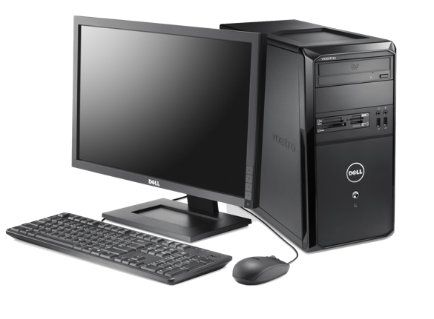
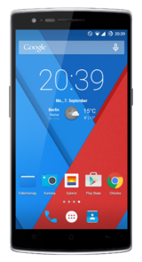
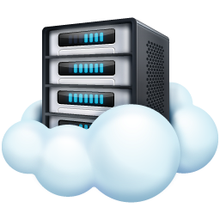
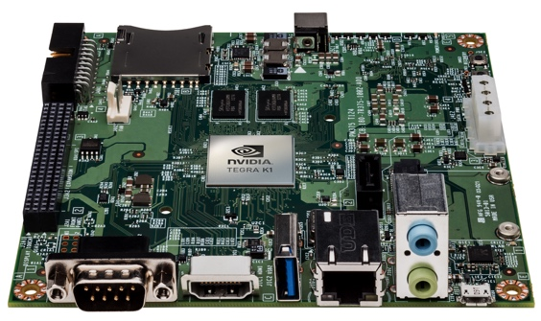
Study Data and Devices
Data collection
Datasets
Devices
CuratedTrec
(3k questions)
+
SQuAD 1.1
(100k questions)
5.5 million articles
12GB storage
Notes:
For the initial measurement study, we use the Wikipedia collection.
We tested two QA datasets that are widely used in the NLP community. The QA dataset consists of questions and the ground truth answer phrases.
In the evaluation, we also test with cross-app and personal datasets.
We ran the QA system on four devices: two high end mobile devices, a desktop PC and the cloud

Slide 12
QA systems cannot run on a smartphone as-is due to limited available memory !
QA Model
>270 MB
256 MB RAM per app
Notes:
In fact, The QA systems cannot run on a smartphone as-is due to limited available memory.
So we designed memory optimizations that I’ll talk about later.
Once they can run on the devices, let’s look at the latency numbers.

Slide 13
Study Finding 1: QA Is Slow on Mobile
Over 80 seconds !
Notes:
Our first finding is that all three QA models take much longer on the phone compared to the cloud server.
The x axis shows different devices and the y axis is the time taken to answer to a question, the higher the worse.
On the cloud, QA only takes a few hundred milliseconds which makes it usable.
But waiting for over 80s on the smartphone makes existing QA systems unusable.

Slide 14
Study Finding 2: Neural Encoding Bottleneck
Other
Search
Bottleneck is in the deep learning layers: document neural encoding!
Scoring
Answers
3%
9%
Text Representation
16%
9%
Neural Encoding of Question
10%
QA systems often process many documents where each one has more words than a question
53%
Neural Encoding of Documents
Existing deep learning optimizations for mobile are not enough for QA
Notes:
To study why QA takes so long on the phone, we broke down the time taken to run the QA system into different components.
The pie chart shows the latency breakdown for running one QA model, which is RNet, on the Jetson TX2 board.
You can clearly see the neural encoding of documents is the bottleneck. It takes up over 50 percentage of the total time.
You may notice that the question encoding does not take too much time.
This is expected because QA systems often process many documents which have many more words than a question. A large amount of documents data are passing through the QA models thus causing huge computation.
Of course, there has been several deep learning optimizations for the mobile, especially for vision but we find these cannot be used for QA. This is because most existing optimizations work for large models, but for QA the model size is not the issue, the issue is the number of documents that need to be processed, you can find more about that in our paper.

Slide 15
DeQA: On-device Question Answering
Measurement study
DeQA latency and memory optimizations
DeQA evaluation
Notes:
Our goal next is to address the challenges specifically in QA models to implement an on-device QA system.
We design a set of latency and memory optimizations for the QA models that significantly reduce memory requirement and QA latency.
We first start with latency optimizations and then describe the memory optimizations.

Slide 16
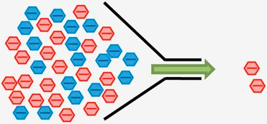
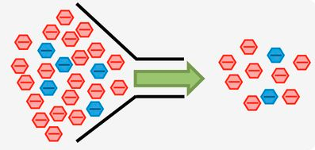
DeQA Design Goal and Key Ideas
Goal: Minimal change to existing QA models
Optimization ideas:
Reduce amount of data to process
Reduce bottlenecks
Notes:
When we design DeQA, we only want to make minimal change to existing QA models, because we want our optimization to be broadly applicable.
The optimization is basically focused on two main ideas: first, reduce the amount of documents to be processed and reduce the bottlenecks in QA models

Slide 17

Challenge 1: How to Reduce Input Documents
less errors
fewer documents
more documents
more errors
Can we use a fixed top N documents for all questions?
Notes:
To achieve these goals, we have to solve two challenges. The first one is how to reduce the input documents data the QA models process.
There is a clear trade-off in reducing number of documents vs accuracy.
Processing more documents will get you more accurate answers but also means you have to spend more time.
Processing fewer documents can help reduce latency but you end up with less accurate answers
So how about setting a fixed number of top N documents for all questions

Slide 18
Processing Fixed Top N Documents Is Inadequate
Document Rank
Notes:
However, this fixed choice is suboptimal.
This figure shows how the correct answers are distributed across the top 150 documents on the TREC dataset.
We found the correct answers are evenly distributed across all ranks.
For example, if you only processing top 50 documents for all questions, you will only get 50% of the correct answers.

Slide 19
Not All Questions Need Many Documents
Hard
Easy
A few documents should suffice
More documents won’t help
Both cases, documents processing can be stopped early
Notes:
However, there are two kinds of questions which may not need large number of documents.
The first set is easy questions -- these are ones where the QA model can easily find the answer in the top few documents.
Another set is hard questions -- these are ones where the QA model is unlikely to find answers even if processing more documents.
In either case we can get away with processing only a few.

Slide 20

DeQA Idea: Dynamic Early Stopping
QA Model
Early Stopping
Classifier
stop
answers
Search Engine
Features
relevance scores
answer scores
duplicate answers
…
continue
Notes:
Based on this intuition, we propose a dynamic early stopping algorithm in DeQA.
The main idea here is to stream documents through the QA model. After processing each document, we use an early stopping classifier to make a decision whether we should continue or not.
The features of the classifier are document relevance scores, answer scores, duplicate answers etc. you can see more details in the paper.
The main point I want to convey here is that this does not require modifying the QA model.

Slide 21
Challenge 2: How to Mitigate Bottlenecks?
Answers
Closer look at neural encoding bottleneck:
Scoring Answers
The question is given at runtime
Neural Encoding
Encoding documents
Encoding documents
Encoding question
Documents can be accessed beforehand
Embeddings
Can we precompute the neural encoding of documents?
QA Model
Notes:
The second challenge we have is how to address the bottlenecks in the QA models.
Recall that in our measurement study, we found the neural encoding of documents is the culprit.
Now let’s take a closer look at the neural encoding bottleneck.
The question is given by the user at the runtime, in contrast, we do have access to the documents beforehand.
So when the system is waiting for questions, can we precompute the documents encoding?
Well, the answer depends on whether documents encoding involves question or not.

Slide 22
DeQA Idea: Offline Neural Encoding for Mobile
RNet (Wang, et al)
MReader (Hu, et al)
QANet (Yu, et al)
D
Q
D
Q
Q
D
Document encoding does not depend on the question
Pre-compute document encoding offline
Notes:
In all 3 models, here is the question encoding, and this is the docments encoding. As you can see, in the lower layers, no connection exists between the question and document encoding blocks, which means document encoding does not depend on the question.
Our idea is to pre-compute the document encoding, when a question comes in, we can just look up the documents encoding without having to compute again.
Of course, there is a tradeoff of storage for latency.

Slide 23

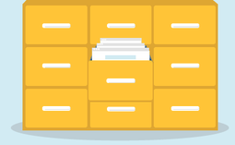
QA Memory Optimizations
Indexing at paragraph level instead of document level
Searching on partial index
refer to the paper for more details
On-demand embeddings lookup
Notes:
We designed memory optimizations so that deep learning QA models can fit into the phone.
Documents are larger blocks that creates memory problem for QA. Instead, we breakdown it into paragraphs and it is more efficient and effective.
Second, instead of loading the entire data index into memory, we iteratively load partial indexes so that they fit into memory.
Finally, instead of loading large word embeddings within QA models into memory, we converted embeddings into a key-value database, and perform on-demand lookup.
Given time constraints, I’m going to skip the details, but you can find more in the paper.
[pause]

Slide 24
DeQA: On-device Question Answering
Measurement study
DeQA optimizations
DeQA evaluation
Notes:
In this work, we evaluated DeQA optimizations.

Slide 25

Evaluation Data
Open Domain Data
Wikipedia
CuratedTrec
(3k questions)
+
SQuAD 1.1
(100k questions)
Personal Data
Single app (email)
Curated 120 QA pairs
Cross-app
Curated 100 QA pairs
Notes:
We evaluated DeQA over 3 data collections. The first one is full Wikipedia, this is a large scale open domain data that is widely used in the NLP community. We use the same QA datasets as in the measurement study.
Recall that we want to support personalized QA on the device, however, there is no publicly available QA dataset over personal on-device data, so we created two QA datasets over personal data.
The first one is a email dataset. We sample emails from the Enron Email Dataset, which is publicly available. For the ground truth, we curated 120 question answer pairs from these emails.
The second one is a cross-app dataset. We collected data from two users as they use 5 different apps for a week. Similarly, we curated 100 QA pairs

Slide 26
Evaluation Systems and Metrics
Compare DeQA with baseline of top3 QA models (RNet, MReader and QANet)
DeQA version does not require changing the QA models
Measure QA latency, accuracy, and energy
Notes:
We evaluated DeQA by comparing with the baseline of top3 QA models (RNet, MReader and QANet). The baseline is the version only with memory optimizations applied so that they can run on the mobile devices.
DeQA version does not require changing the QA models
We measured the end to end QA latency, accuracy and energy of both the baseline and DeQA

Slide 27
DeQA Brings Huge Latency Benefits
16x speedup
13x speedup
Notes:
Let’s look at the latency results.
This figure shows the latency comparison of DeQA with and without optimizations on the Wikipedia dataset. Y-axis is the latency, the higher the worse.
You can see that DeQA with optimizations can reduce the latency from over 80s to 4~6s, which is 16x speedup for all three models.
This indicates DeQA optimizations are effective although different QA models have very underlying architectures.
On the right figure, it shows the QA latency of all 3 QA models on the 5 cross app data. DeQA is also able to reduce latency from 50s to under 5s, providing 13x speedup. The numbers for email data is also similar.

Slide 28
DeQA Causes Minimal Accuracy Drop
QA over Wikipedia data
~1% drop for both single app (email) and cross-app data
Notes:
Next, let’s look at the QA performance in terms of accuracy.
We measured the accuracy drop of DeQA compared to the original QA models.
In the figure on the left, y-axis is the percentage of accuracy drop. You can see for all 3 QA models on the Wikipedia datasets, the accuracy drop is within 1%
We also did the same accuracy measurement on the single email app and cross-app data.
The accuracy drop is also minimal.

Slide 29
DeQA Significantly Reduces Energy Consumption
Reduce energy by 9x
Notes:
We measured the energy consumption of DeQA of answering one question.
In this figure, Y-axis is the average energy per question, the unit is joule.
You can see DeQA with optimizations can significantly reduce energy by 9 times.

Slide 30


Other Key Results of DeQA
Significantly reduce QA latency from over 20s to under 5s
on the mobile TX2 board (6x speedup)
Each DeQA optimization incrementally gives benefits
Overhead of on-device indexing over cross-app data is minimal
Notes:
Given time constraints, I’ll briefly summarize some other key results of DeQA.
On the mobile Jetson TX2 board, we can reduce the QA latency from over 20s to under 5s, providing 6x speedup.
And we evaluated individual optimization effectiveness, each DeQA optimization incrementally gives benefits
The overhead of on-device indexing over cross-app data is minimal both for energy and latency.

Slide 31
Main Takeaways of DeQA
On-device question answering system that can adapt state-of-the-art models to support cross-app QA services
Set of memory- and latency- optimizations which require no change to the QA models
Reduces QA latency on mobile from over a minute to 3~5s
Notes:
Now I want to conclude the talk by summarizing the main takeaways of DeQA.
First, DeQA is a on-device question answering system that can adapt state-of-the-art models to support cross-app QA services
Secondly, DeQA consists of a set of memory- and latency- optimizations which require no change to the QA models
Lastly, DeQA can effectively reduce QA latency on mobile from over a minute to 3~5s.
Thank you! I’m happy to take questions.

Slide 32
DeQA: On-Device Question Answering
Qingqing Cao, Noah Weber, Niranjan Balasubramanian, and Aruna Balasubramanian

